Slide 1
DEEP SEA PHYSIOLOGY
Dr.T.S.Asta Eshwaran
Dept. of Physiology
SKHMC, Kulasekharam

Slide 2
In deep sea and mines, the problem is due
to high barometric pressure.
Compression effect on the body and internal
organs
Decrease in volume of gases.
(Barometric pressure or Atmospheric pressure)

Slide 3
BAROMETRIC PRESSURE AT DIFFERENT DEPTHS
At sea level, the barometric pressure is 760
Mm Hg, which is referred as 1 atmosphere
pressure.
At the depth of every 33 feet (about 10 m), the
pressure increases by 1 atmosphere.
Thus, at the depth of 33 feet, the pressure is 2
atmospheres. It is due to the air above water and
the weight of water itself.

Slide 4
At the depth of 10 mt below the sea the
volume of air in lungs will be half at sea level.
So the respiratory gases will be at high
pressure in lungs, blood and in the tissues with
severe side effects.
In respiration N₂ O₂ CO₂ are used by under
Water divers.

Slide 5
Depth (feet) | Atmospheric pressure (mm Hg) | Effects on the subject
Sea level 1 – | 1 | -
33 | 2 | -
66 | 3 | -
100 | 4 | Symptoms of nitrogen narcosis appear
133 | 5 | 5 Lack of concentration Becomes jovial and careless
166 | 6 | Starts feeling drowsy
200 | 7 | 7 Feels fatigued, weak and careless
233 | 8 | 8 Looses power of judgment Unable to do skilled work
266 | 9 | Becomes unconscious
Barometric Pressure: 1 atmospheric pressure = 760 mm of hg

Slide 6
EFFECT OF HIGH BAROMETRIC PRESSURE
Nitrogen Narcosis
It is common in deep sea divers and under
water tunnel workers, because who breathe air
under high pressure.
If nitrogen is breathed at high pressure for
some hours leads to nitrogen narcosis.
Severity increases as depth increases(Pressure
of the gas increase).

Slide 7
Eighty percent of the atmospheric air is
nitrogen. Being an inert gas, it does not produce
any known effect on the functions of the body at
normal atmospheric pressure (sea level).
When a person breathes pressurized air as in
deep sea, the narcotic effect of nitrogen appears.

Slide 8
Mechanism
Nitrogen is soluble in fat. During compression
by high barometric pressure in deep sea, nitrogen
escapes from blood vessels and gets dissolved in the
fat present in various parts of the body, especially
the neuronal membranes.
Dissolved nitrogen acts like an anesthetic agent
suppressing the neuronal excitability.
Nitrogen remains in dissolved form in the fat till
the person remains in the deep sea.

Slide 9
Symptoms
Upto 120 feet person does not felt any
symptoms.
At the depth of 150 to 200 ft person become
drowsy.
In greater depth up to 250 ft person become
extremely fatigued ,weak, mental confusion
and muscular weakness.
Beyond the depth of 300ft. at 10 atmospheric
pressure diver becomes comatose.

Slide 10
Prevention
Nitrogen narcosis can be prevented by mixing helium with oxygen.
Limiting the depth of dives.
Advantages of Helium
It does not produce any effect upto 650 ft.
Low density air and give little airway
resistance and easier to breath.
Due to less atomic weight it diffuses more
rapidly than nitrogen through the body tissues
also removed more quickly.

Slide 11
Helium is less soluble in than nitrogen in the
body fluids which reduces the quantity of bubbles.
Treatment
Symptoms of nitrogen narcosis completely disappear when the diver returns to a depth of 60 feet.
There is no need for any further treatment since nitrogen narcosis does not have any hangover effect.
However, the physician should be consulted if the diver loses consciousness.

Slide 12
DECOMPRESSION SICKNESS
It is also known as..
Dysbarism, Compressed air sickness
Caisson disease, bends or diver’s palsy.
Definition
Decompression sickness is the disorder that
occurs when a person returns rapidly to normal
surroundings (atmospheric pressure) from the
area of high atmospheric pressure like deep sea.

Slide 13
Cause
High barometric pressure at deep sea leads to
compression of gases in the body.
Among the respiratory gases, oxygen is utilized by tissues. Carbon dioxide can be expired out.
But nitrogen is an inert gas, it is neither utilized nor expired
Under high atmospheric pressure it escapes from blood vessels and enter into the organs.

Slide 14
As long as the person remains in deep sea, nitrogen remains in solution and does not cause any problem. But, if the person ascends rapidly and returns to atmospheric pressure, decompression sickness occurs.
Due to sudden return to atmospheric pressure, the nitrogen is decompressed and escapes from the tissues very fast.
Being a gas, it forms bubbles while escaping rapidly. The bubbles travel through blood vessels and ducts. It obstruct the blood vessels and form air embolism leading to decompression sickness.

Slide 15
Underground tunnel workers who use the caissons (pressurized chambers) also develop decompression (caisson disease) sickness.
Pressure in the chamber is increased to prevent the entry of water inside.
Decompression sickness occurs in a person who ascends up rapidly from sea level in an airplane without any precaution.

Slide 16
Symptoms
Dizziness and shortness of breath
Pain in joints and tissues.
Numbness, tingling or pricking sensation (Paresthesia) and itching.
Muscle cramps
Temporary paralysis.
Occlusion of coronary artery and blood vessels of brain leads to tissue damage in brain and spinal cord.
At last unconsciousness and death.

Slide 17
Prevention
Stepwise ascent allows nitrogen to come back
to the blood, without forming bubbles. It
prevents the decompression sickness.
Treatment
Recompression: It is done by keeping the person in a recompression chamber. Then, he is brought back to atmospheric pressure by reducing the pressure slowly.
Hyperbaric oxygen therapy may be useful.

Slide 18
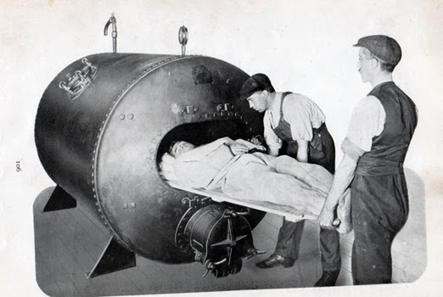
Old Model recompression chamber

Slide 19
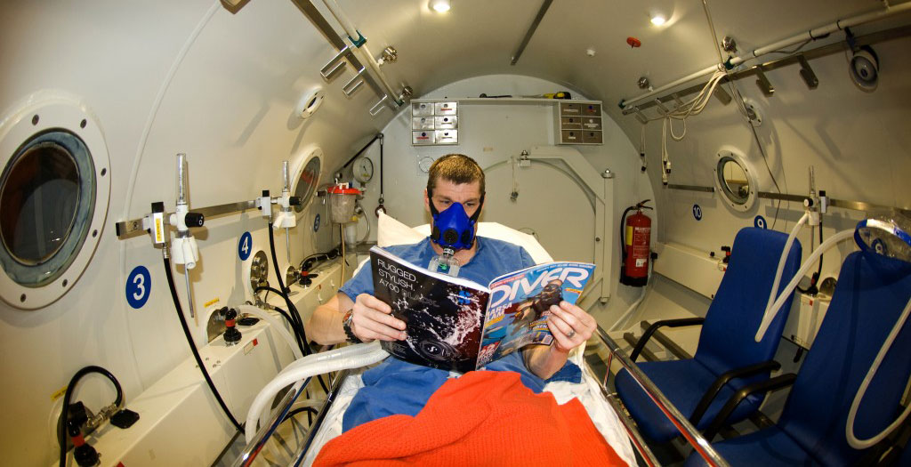
New Model recompression Chamber

Slide 20
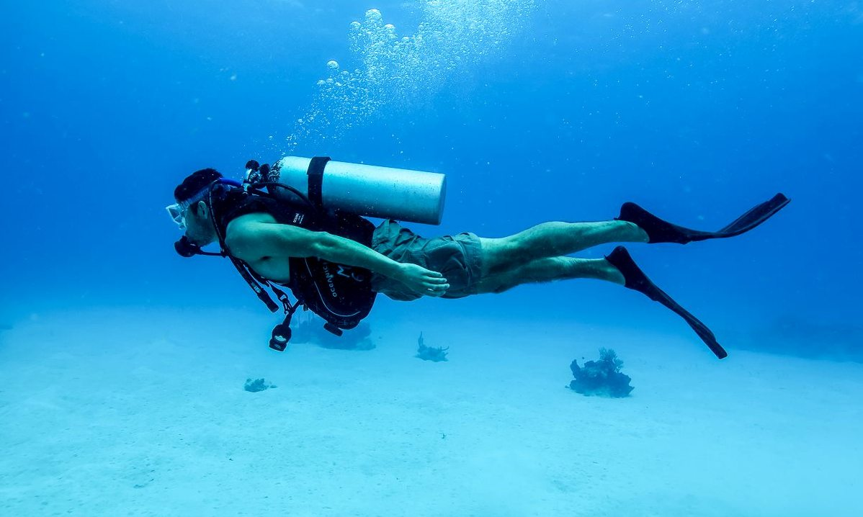
SCUBA

Slide 21
SCUBA (Self Contained Underwater Breathing Apparatus)
Used by the deep sea divers and the underwater tunnel
workers, to prevent the ill effects of increased barometric
pressure in deep sea or tunnels.
This instrument can be easily carried and it contains air
cylinders, valve system and a mask. By using this
instrument, it is possible to breathe air or gas mixture
without high pressure. Also, because of the valve system,
only the amount of air necessary during inspiration enters
the mask and the expired air is expelled out of the mask.

Slide 22
Disadvantage
Person using this can remain in the sea or
tunnel only for a short period. Especially, beyond
the depth of 150 feet, the person can stay only
for few minutes.

